Slide 1
Industry Performance Analysis
Exploratory Data Analysis (EDA) and Supervised Machine Learning
Prepared by Adiesh Koul

Slide 2
Project Overview
• Analyze industry performance data
• Perform EDA
• Build machine learning models
• Generate business insights

Slide 3
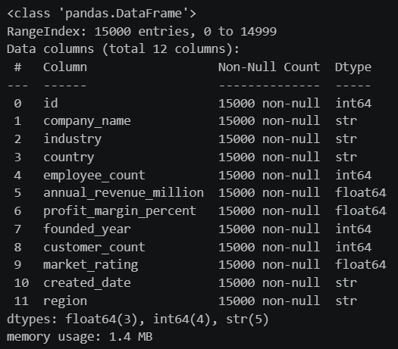
Dataset Information
• 15,000 records
• 12 variables
• Numerical, categorical and date features
• Industry, revenue, employees, customers, ratings

Slide 4
EDA Process
• Data exploration
• Univariate analysis
• Bivariate analysis
• Multivariate analysis
• Outlier detection

Slide 5
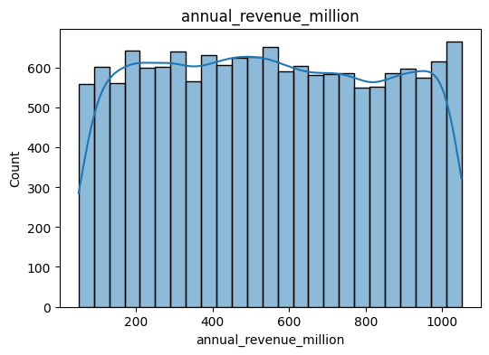
Univariate Analysis
• Studied individual variables
• Calculated mean, median, standard deviation
• Measured skewness and kurtosis

Slide 6
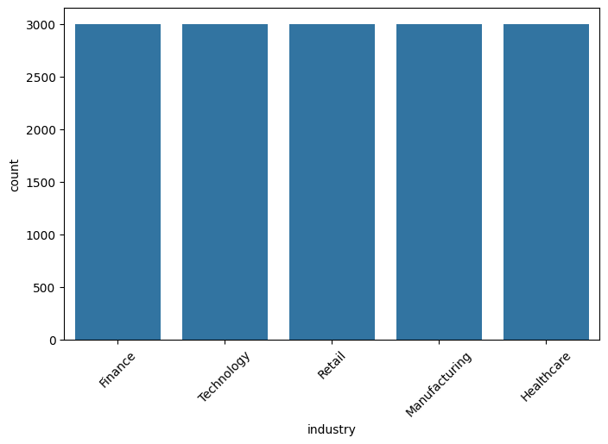
Bivariate Analysis
• Examined relationships between variables
• Correlation analysis
• Scatter plots and comparison charts

Slide 7
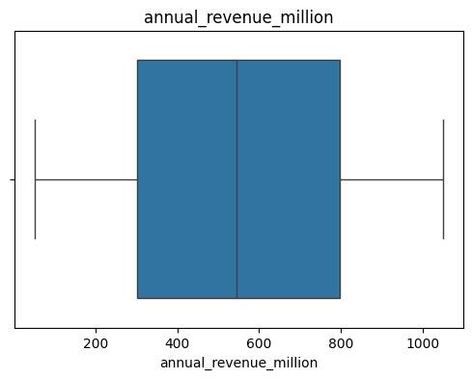
Outlier Detection
• Boxplots
• IQR Method
• Z-Score Method
• Outliers retained as genuine business cases

Slide 8
Key Insights
• Revenue is positively skewed
• Employee count relates to revenue
• Customer count influences revenue
• Technology sector performs strongly

Slide 9
Machine Learning
Models Used:
• Linear Regression
• Random Forest Regressor
Target Variable: Annual Revenue

Slide 10
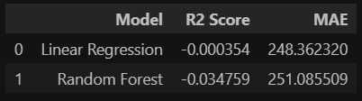
Model Results
• Compared model performance using R² and MAE
• Random Forest selected as the better-performing model

Slide 11
Business Implications
• Supports industry benchmarking
• Helps understand growth patterns
• Useful for strategic decision-making

Slide 12
Conclusion
• Completed EDA and machine learning workflow
• Generated actionable business insights
• Demonstrated data analytics using Python

